Slide 1


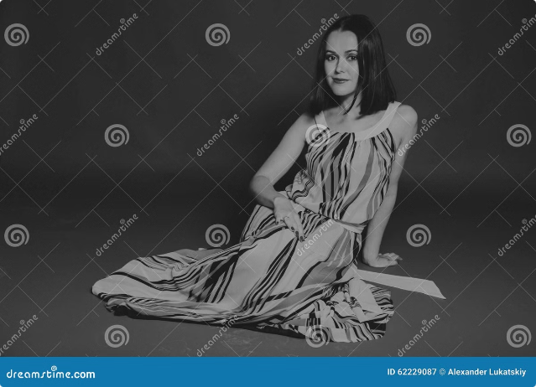


Priya Fashion Boutique: Your Perfect Fit
Welcome to Priya Fashion Boutique, your destination for custom-tailored ladies suits. I'm Sarishta, and for 22 years, I've been helping women look and feel their best.
by Sarishta handa

Slide 2


Eliminating Fitting Frustrations
1
No More "Tight Hai"
2
No More "Loose Hai"
Say goodbye to ill-fitting suits that pinch and restrict movement. Our expert tailors ensure a perfect fit from the start.
We understand that a loose suit can be just as unflattering as a tight one. We create suits that fit you beautifully, without being too snug or too baggy.
3
No More "Yahan Se Tedha Hai"
4
No More "Yeh Match Nahin Hua"
Our attention to detail ensures that your suit is symmetrical and balanced, with every seam and stitch perfectly aligned.
We pay meticulous attention to fabric matching and color coordination, so every element of your suit seamlessly blends together.

Slide 3
Timeless Style and Modern Trends
Classic Designs
Modern Fashion
Personalized Touch
We offer a wide array of classic styles that never go out of fashion. From traditional salwar kameez to elegant churidaars, we have something for every taste.
We also embrace the latest trends, incorporating modern cuts, patterns, and embellishments into our designs.
You can choose from our extensive fabric collection or bring your own. We'll work with you to create a unique and personalized suit that reflects your style.

Slide 4

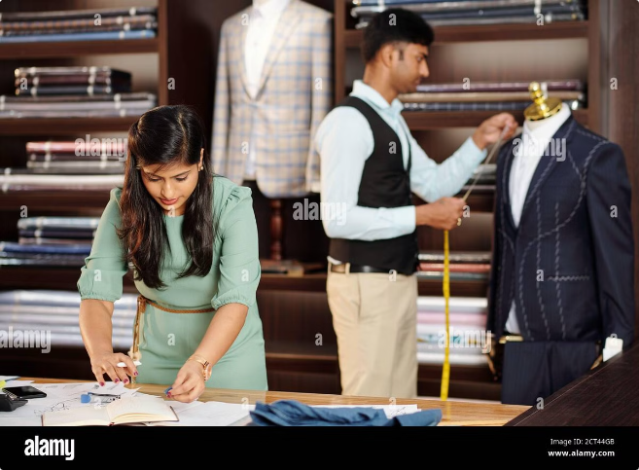
Expert Tailoring for a Perfect Fit
1
Detailed Measurements
We take precise measurements to ensure a perfect fit. Our tailors will pay careful attention to every detail, from your bust and waist to your shoulder width and sleeve length.
2
Expert Stitching
Our experienced team of tailors has the skills and knowledge to craft suits that are both stylish and durable.
3
Careful Finishing
From hem lines to buttonholes, every aspect of your suit is meticulously finished to create a flawless look.

Slide 5

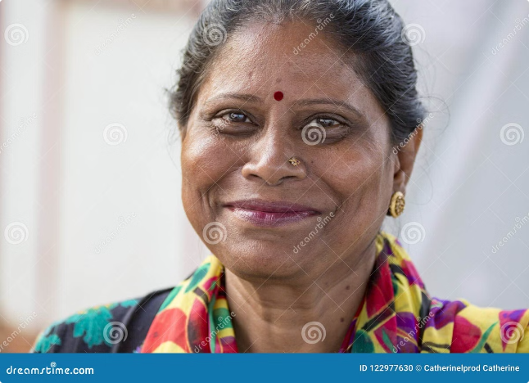
Save Time, Money, and Stress
Cost-Effective Solutions
Our prices are competitive and offer exceptional value for the quality and craftsmanship we provide.
No More Alterations
With a perfect fit from the start, you can avoid the hassle and expense of alterations after purchasing your suit.
Stress-Free Experience
We take care of everything, from fabric selection to stitching and fitting. You can relax and enjoy the process.

Slide 6





Serving a Global Clientele
Across India
Customers from all over India have come to trust Priya Fashion Boutique for their custom tailoring needs.
International Clients
We also serve clients abroad, showcasing the beauty of Indian fashion on a global stage.
Positive Reviews
Our satisfied customers are our best ambassadors. We have a loyal following of clients who appreciate our dedication to quality and personalized service.

Slide 7

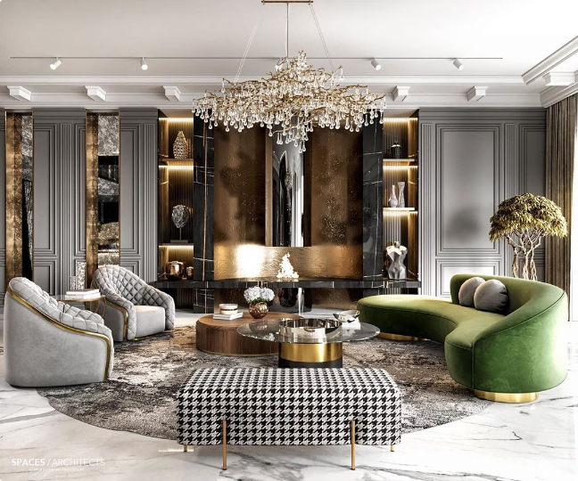



Visit Priya Fashion Boutique Today
Location
Maharaja Complex, Opposite PNB Main Branch, Hoshiarpur Near clock tower.
Contact
9465386975
Experience the Difference
Visit Priya Fashion Boutique and discover the joy of wearing a suit that fits you perfectly and makes you feel confident and beautiful.

Slide 8

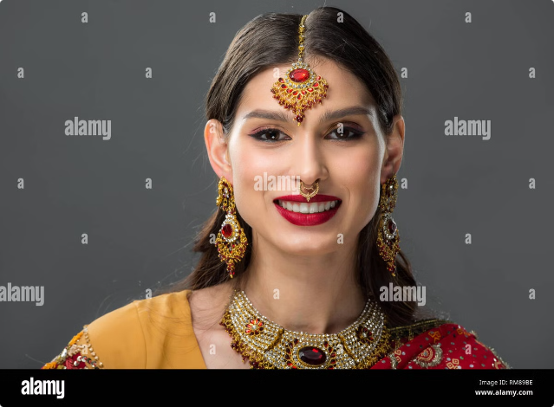
Testimonials
“Sarishta and her team are amazing! I've been a customer for years and always get compliments on my suits. ” - Mrs. Sharma
“The attention to detail at Priya Fashion Boutique is incredible. They made my wedding outfit absolutely perfect.” - Ms. Kaur

